Slide 1
Lecture 3: Async Programming
CS-546 – Web Programming

Slide 2
What is Asynchronous Code?

Slide 3
How is JavaScript run?
JavaScript runs off of what is known as an event loop.
Every statement gets added into a queue of instructions to run, that are processed in order.
However, some operations (such as making network requests, file calls, etc.) are very expensive and would normally use up huge amounts of time and resources in order to complete. This would normally result in blocking execution.
Rather than allowing these to block all execution, we can use asynchronous code in order to continue execution and run the code that relies on the results of expensive operations in callbacks that occur at a later point in time.

Slide 4
What is synchronous code
Synchronous code is code that runs in the order it is written. This is what we are used to as programmers: we write what happens and it gets done in the order expected.
The key to remembering the difference between asynchronous and synchronous programming is to view all programming as a chain of operations.
In synchronous code, these operations are run sequentially. Operations that are written first, will be run first. This will hold true even for functions that run callbacks despite being synchronous, such as [].map
In asynchronous code, some operations are run non-sequentially. Operations that are written first may run before other operations, but operations that passed as parameters to asynchronous functions can get run at any time in the future. No order is guaranteed.

Slide 5
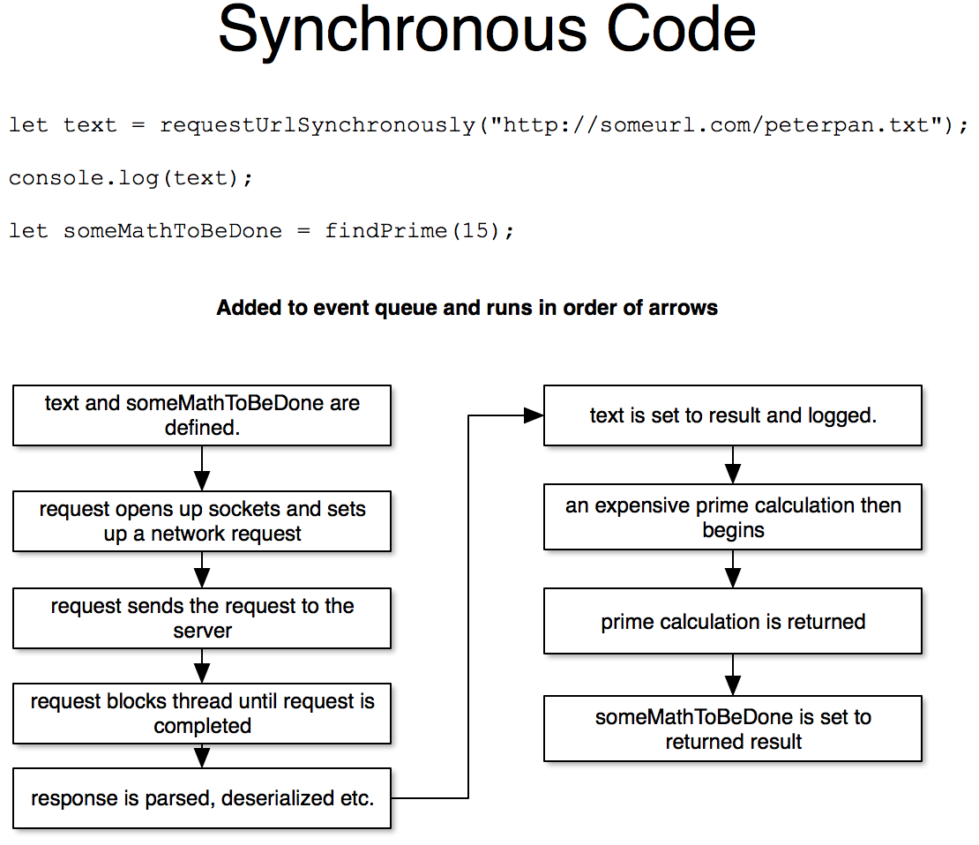

Slide 6
What is asynchronous code
Asynchronous code is code that is not run in the order that which it is written.
Traditionally, asynchronous functions will take callback functions in order to run code that relies on the result of the function.
Nowadays, this pattern is abstracted away and many asynchronous functions return promises.
Note: if you have multiple asynchronous functions, there is no guarantee that the first function that is started will finish before the following asynchronous actions. You must therefore often start the second asynchronous actions after the first is completed.

Slide 7
A callback function?
In JavaScript, you can pass functions as the arguments for other functions.
This is very useful for asynchronous code, as you can pass a callback function to a long-running function. That way, when the original function is complete, the result will be passed to the callback once the long-running process is complete. Since the long running function will yield its time to run many times over (since it is asynchronous), we are not able to simply place code after our asynchronous function and assume that it will run in the order we write it.
For example:
You can make a database call that runs asynchronously, and when the result comes back pass the result to the callback
You can make a network request that runs asynchronously, and when the request is completed the response is passed to the callback

Slide 8
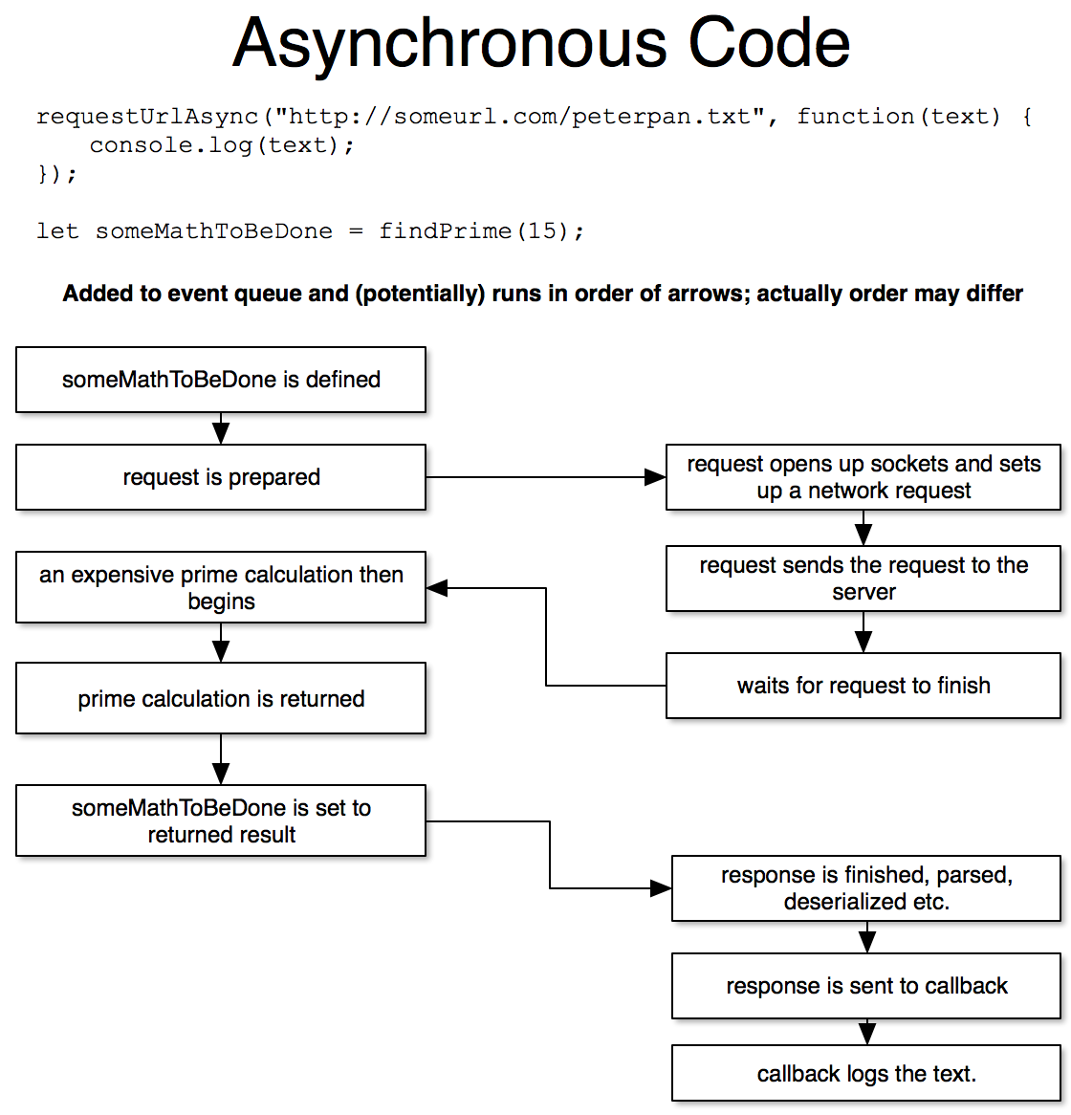

Slide 9
Where will we use asynchronous code?

Slide 10
When working with files
There are many file system functions that are exposed through node’s native fs module. Most of these are asynchronous, as I/O operations on a computer are notoriously slow.
You can do many things such as
Read and write files
Get directory listings
Create and delete directories
Watch for file changes to occur!
And more…
You can read about the fs module at
https://nodejs.org/api/fs.html

Slide 11
Running a Web Server
When you run your own web server, you have no idea when someone will actually access your routes (if they will at all!).
For this reason, all your server code will be asynchronous. Your server code will have to wait for a network request to initiate before sending data back down to the client.

Slide 12
Making an HTTP Request
Making an HTTP request is an asynchronous operation, since it can take a very long time for the request to complete.
There are many more parts than you would expect to making an HTTP request, and the responding server (if it exists) could take any amount of time to complete the request.
For this reason, HTTP requests are asynchronous so that the file can be downloaded and such while other operations are completing, rather than blocking and holding up your entire application when a server is responding slowly.

Slide 13
Database Operations
When making a call to a database, you generally use asynchronous methods.
Connecting to a database, finding entries, creating new entries, updating old entries, and deleting entries are all asynchronous operations.
There is a great deal of network traffic / inter-process communication that has to occur to perform any database operation, and then a result must be awaited.
For this reason, database operations are asynchronous: there is no need to block the entire node process to wait for the relatively long task of a query. This also prevents node from blocking on a long-running database query.

Slide 14
Example 1: Reading Files With Callbacks

Slide 15
Our Goal
We are going to write a node script that will perform the following chain of events:
We will use prompt to ask the user for the name of a file to open
Once that is complete, we will read the file
Once that is complete, we will reverse the content of the file
Once that is complete, we will save the file again
You can see this code demonstrated in the callbacks folder.

Slide 16
Things to Note
Callbacks are the most basic and simplest form of managing asynchronous operations in JavaScript, but come with a number of difficulties
Code becomes unreadable; you end up with code that goes deep and ends in the middle of your file, rather than code that runs as we’re used to (top to bottom).
Handling errors becomes intensely confusing, as you have to check for them at the start of every callback

Slide 17
Promises

Slide 18
What is a promise?
A promise is an object that represents the eventual result of some asynchronous operation
Rather than blocking, an asynchronous method will go through the following steps:
Immediately return a new Promise object, which takes a callback to run on success and failure
Prepare the asynchronous call
Run the asynchronous component of the method; due to how JavaScript’s event queue works, this will always begin to run after the current method ends.
Return a promise that will resolve the request after the asynchronous operation is completed

Slide 19
Why are they useful?
Promises allow us to write code that resembles synchronous code in how it is syntactically written, while actually writing powerful and complex asynchronous code!
For example, promise based code:
https://github.com/Stevens-CS546/CS-546/blob/master/Lecture%20Code/lecture_03/promises/app.js
Is much easier to follow compared to callback-based code:
https://github.com/Stevens-CS546/CS-546/blob/master/Lecture%20Code/lecture_03/callbacks/app.js
It is a cleaner way of performing asynchronous operations, rather than infinitely nesting callbacks, which causes for easier development.

Slide 20
Using promises
Promises have a property on them called then.
then is a function that takes 1 to 2 parameters: one necessary callback to handle a successful case that will receive the resulting data, and one optional callback for handling errors.
When then is run, it returns another promise!
The new promise will return the result from the callback run from the first promise! This allows you to keep chaining asynchronous operations

Slide 21
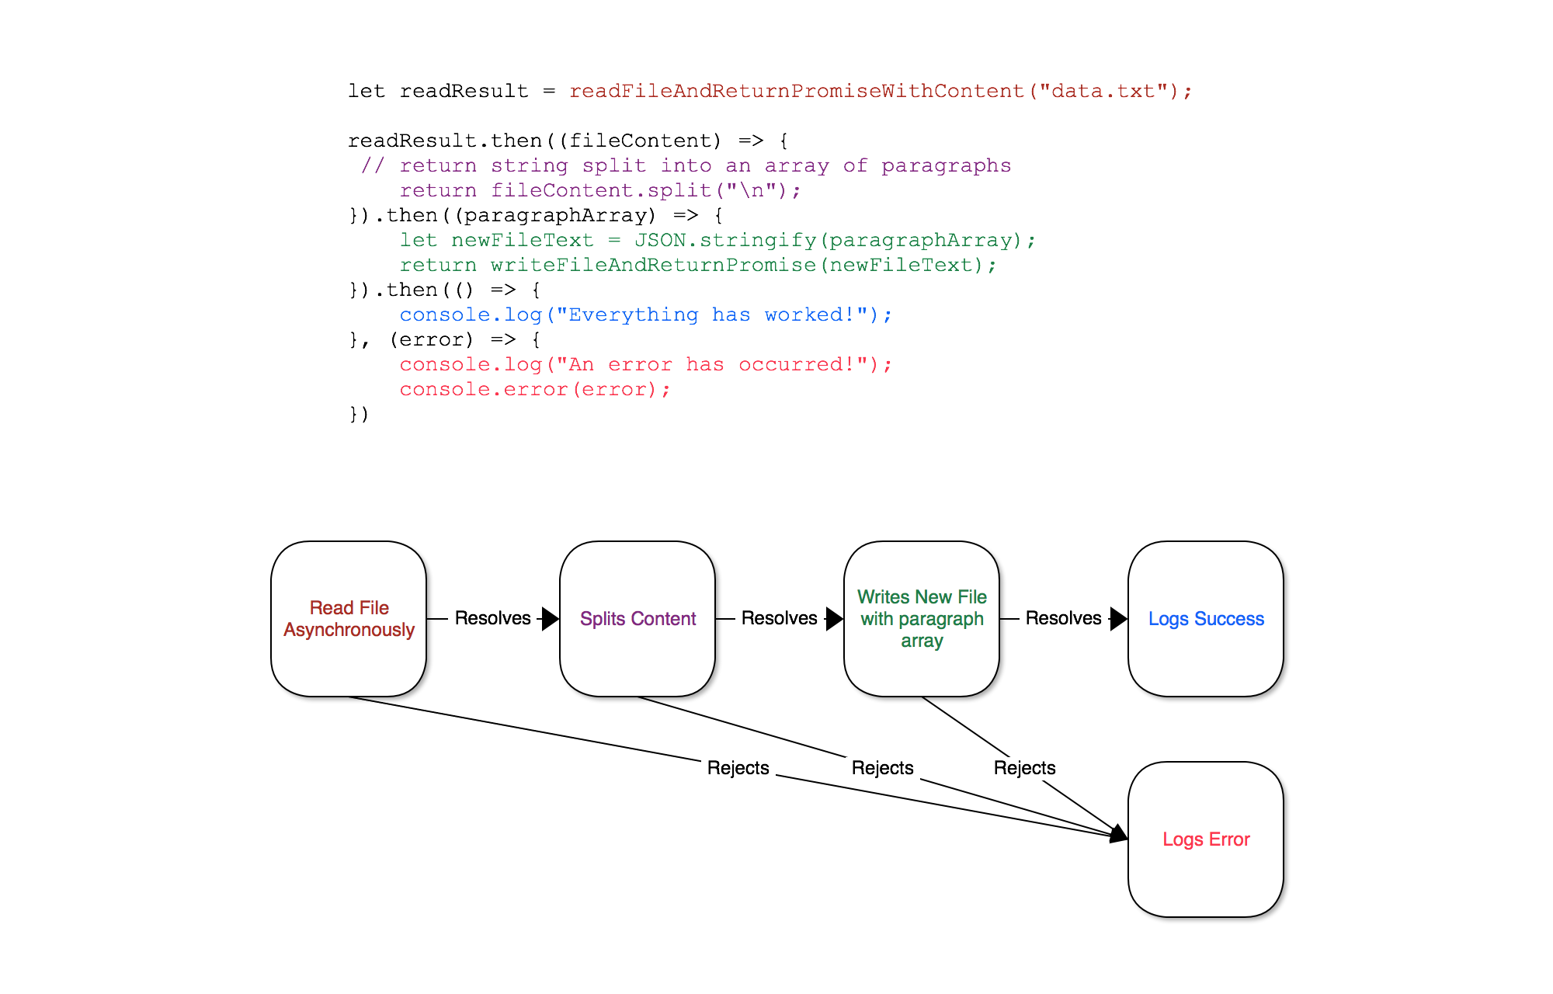

Slide 22
Catching Errors
While promises can chain, they can also have errors!
When a promise has an error, all promises that chain off that promise will reject with the same error until it is caught and handled.
The second callback of then allows you to catch any errors that have occurred to that point. From there, you may:
Log and rethrow the error to keep the chain from being fixed.
Recover, and return a value (or a promise that will resolve to a value!) that will be used in order to continue the chain successfully from that point
Alternatively, you can use the .catch method on a promise, which is essentially .then(null, (errorHandler) => {})

Slide 23
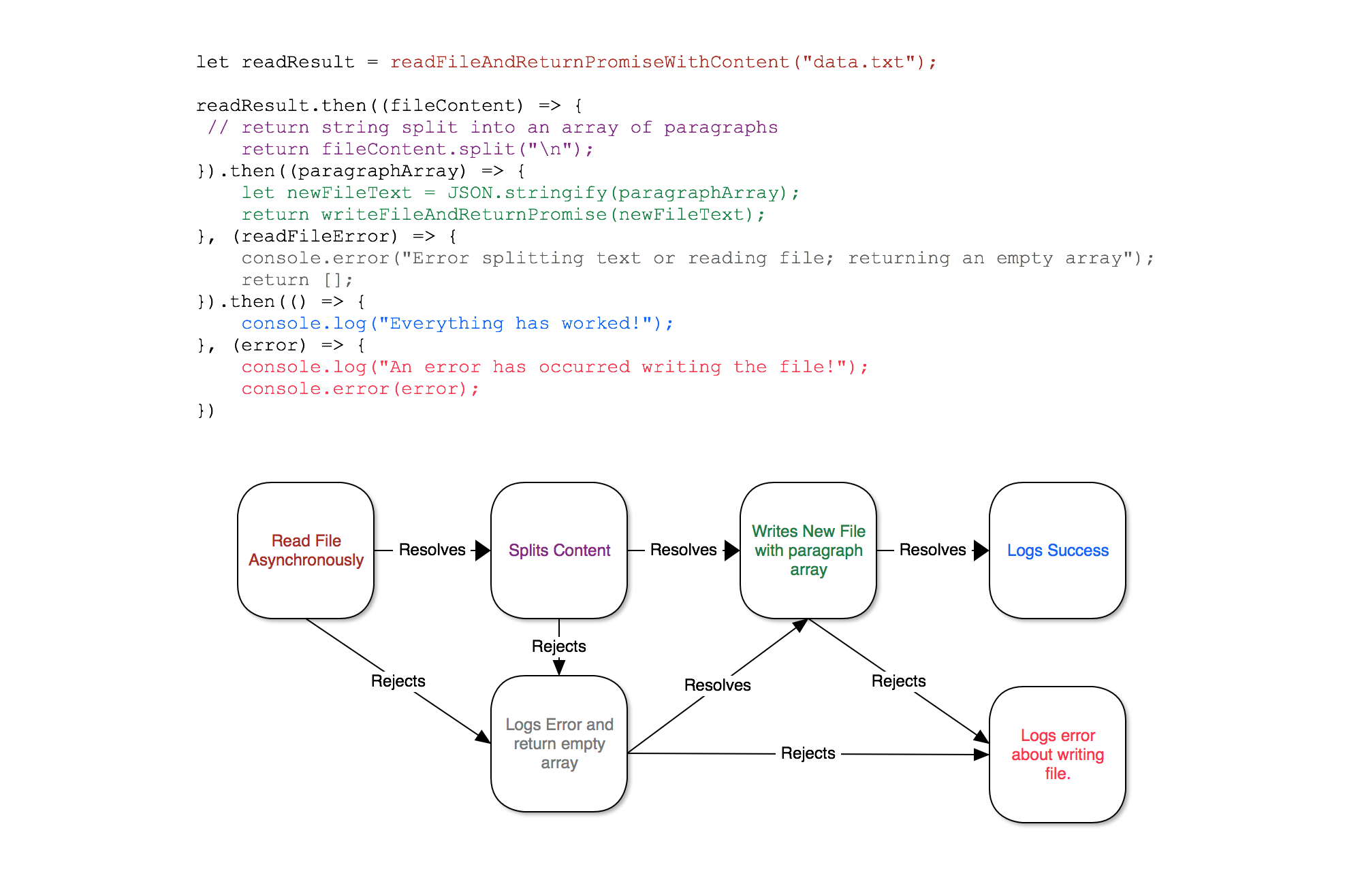

Slide 24
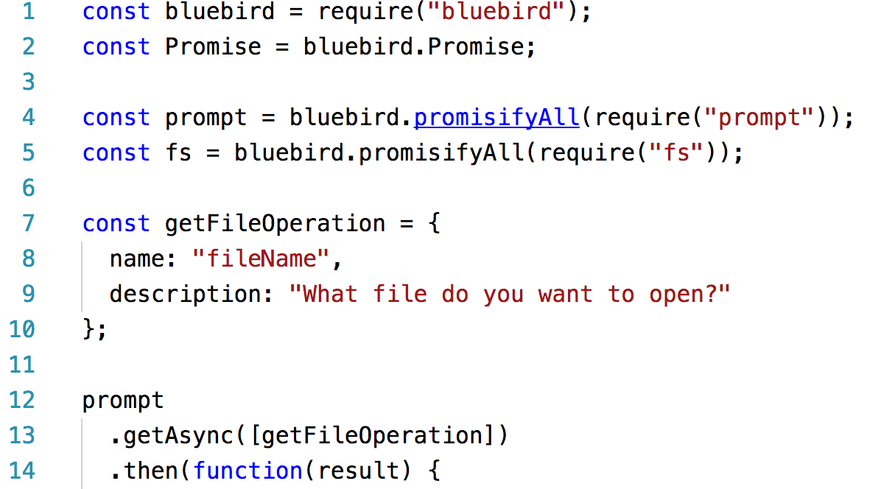
Converting from Callbacks to Promises
We will use a node package called bluebird to convert methods that take callbacks to methods that return promises.
To convert one method, we use bluebird’s promisify method; to convert each method in an object, we use promisifyAll
This will make a copy of each method, that ends with the term Async and returns a promise.

Slide 25
Example 2: Reading Files With Promises

Slide 26
Converting a callback to a promise
Rather than using callbacks, many people opt to convert their methods to return promises, even if they use code that internally uses callback.
There are two strategies for converting converting callbacks to promises. Let us take, for example, converting fs.readFile from a callback to a promise:
Manually writing a method that returns a promise, which internally calls fs.readFile
Using a promise library, such as bluebird, to make a copy of fs that has methods auto generated to return promises. It will make a method called readFileAsync, which returns a promise.
This concept is called colloquially known as promisifying an operation.

Slide 27
Our Goal
We are now going to convert the previous script to perform the same operation, however this time we will use promises.,
We will first use Bluebird to promisify the entirety of fs and prompt.
We will then perform our goals from before, this time using promises.
You can see this code demonstrated in the promise folder.

Slide 28
async / await

Slide 29
Asynchronous Code is messy.
In general, writing asynchronous code is syntactically messy.
Ends up in deeply nested callbacks
Creates huge promise chains
Hard to error check
As a result, over the last several years, the JavaScript language has added a concept of async functions, and awaiting the end of an asynchronous operation.

Slide 30
async functions
A function can be defined as an async function, which means that the function will automatically return a promise (even if there are no asynchronous operation in that function).
By marking a function as async, you allow the await keyword to be used inside of the function.
Besides their ability to await promises and their gauranteed returning of a promise, there is no difference between a function and an async function.

Slide 31
awaiting promises
The await keyword can only be used inside of an async function
When you await a promise, you will cause the rest of the function to execute after that promise resolves or rejects. If the promise rejects, an error will be thrown on the line that awaits it.
This allows you to use try / catch syntax in asynchronous operations!
The result of an await operation is whatever the promise resolves to. If the promise does not resolve to a value, it will have a result of undefined.

Slide 32
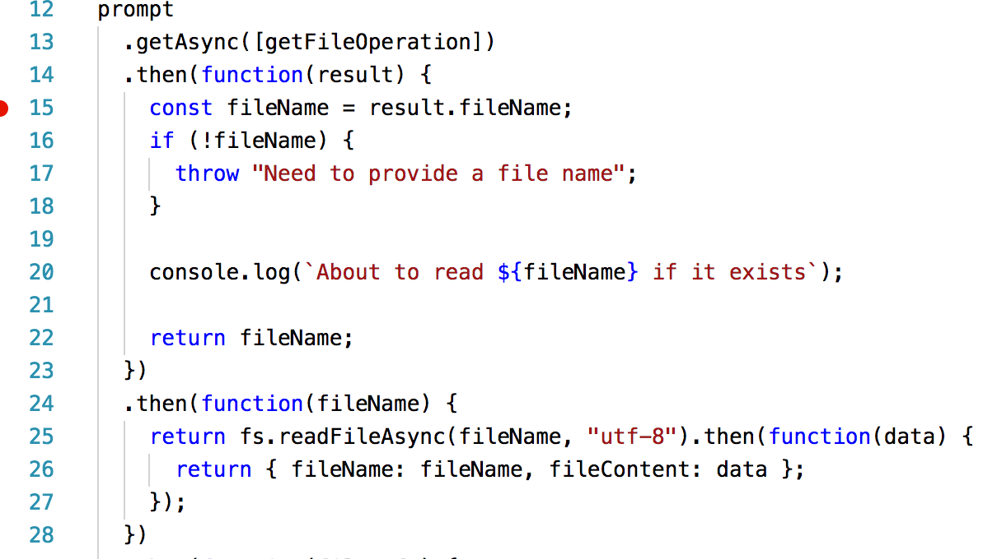
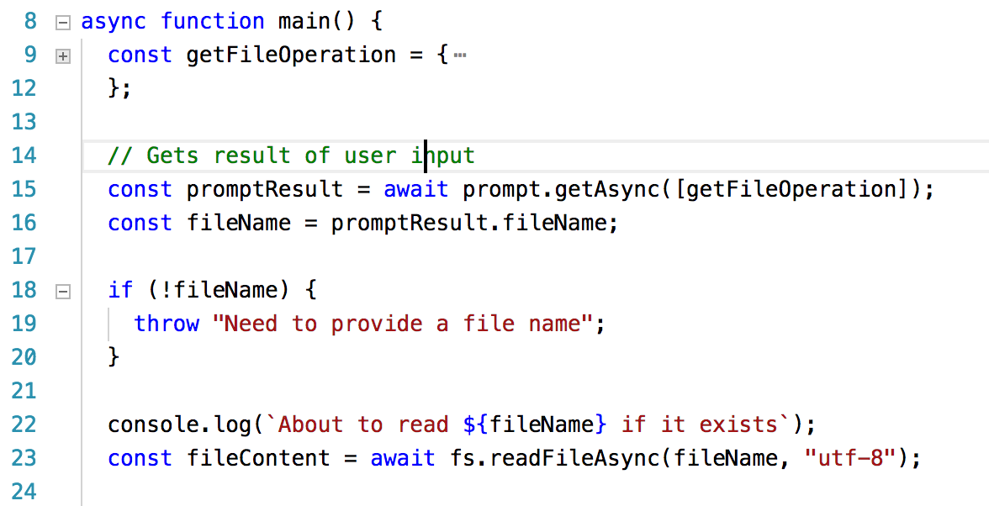
Example
On the top, we see promises. On the bottom, we see the same code written in async / await notation.

Slide 33
What benefit does that have?
By using async and await we can create code that is written and read in the order that which the operations will complete, while still allowing the functions themselves to be asynchronous.
Internally, the functions that run async code will still be constantly giving up execution cycles to perform other operations while they continue their tasks, however your code can abstract over that.

Slide 34
Example 3: Reading Files With async / await

Slide 35
Our Goal
We are now going to convert the previous script to perform the same operation, however this time we will use async / await.,
We will still use Bluebird to promisify the entirety of fs and prompt.
We will then perform our goals from before, this time using promises.
You can see this code demonstrated in the async-await folder.

Slide 36
Questions?

